Slide 1



Linguistic Temporal Trajectory Analysis
Bennett Kleinberg, Isabelle van der Vegt, Maximilian Mozes
bennett.Kleinberg@ucl.ac.uk // isabelle.vegt.17@ucl.ac.uk // mozes@cs.tum.edu
Workshop
2018 European Symposium Series on Societal Challenges in Computational Social Science
December 05, 2018

Slide 2
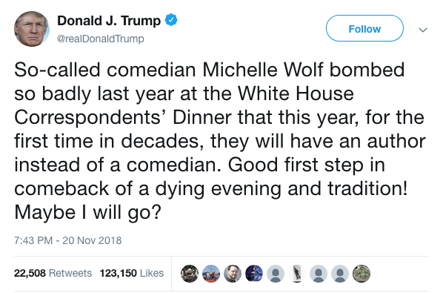
Why this workshop?
Tweet sentiment?
-0.75 (syuzhet::get_sentiment(df.txt$text[2]))
sentence_id word_count sentiment
1 34 -0.17149859
2 11 0.07537784
3 4 0.00000000
(sentimentr::sentiment(df.txt$text[2]))

Slide 3

Why this workshop?
- YouTube data (strangely) untapped data source
- Think of: vloggers, news channels, …
Two problems:
Vlogs are looooong strings of text
Automated transcripts are not punctuated

Slide 4
Static vs dynamic approaches
we the citizens of america are now joined in a great national effort to rebuild our country and restore its promise for all of our people together we will determine the course of america and the world for many many years to come […]
1 sentiment score
Long texts might blur the sentiment!
imagine this is a super positive part of a fantastic text with big beautiful words the best words
but now we talk about the bad guys and the crime and terror going on this is really bad and we have to stop this invasion
+
-

Slide 5
Static vs dynamic approaches
we the citizens of america are now joined in a great national effort to rebuild our country and restore its promise for all of our people together we will determine the course of america and the world for many many years to come […]
Dynamic, moving sentiment
imagine this is a super positive part of a fantastic text with big beautiful words the best words
but now we talk about the bad guys and the crime and terror going on this is really bad and we have to stop this invasion

Slide 6
linguistic
temporal
trajectory
analysis
Fits in ‘data science’ workflow
Extensions to ts modelling
New features for supervised ML
Text is everywhere
Everything is text
Exploits natural text progression
Temporal axis crucial for dynamic approach

Slide 7
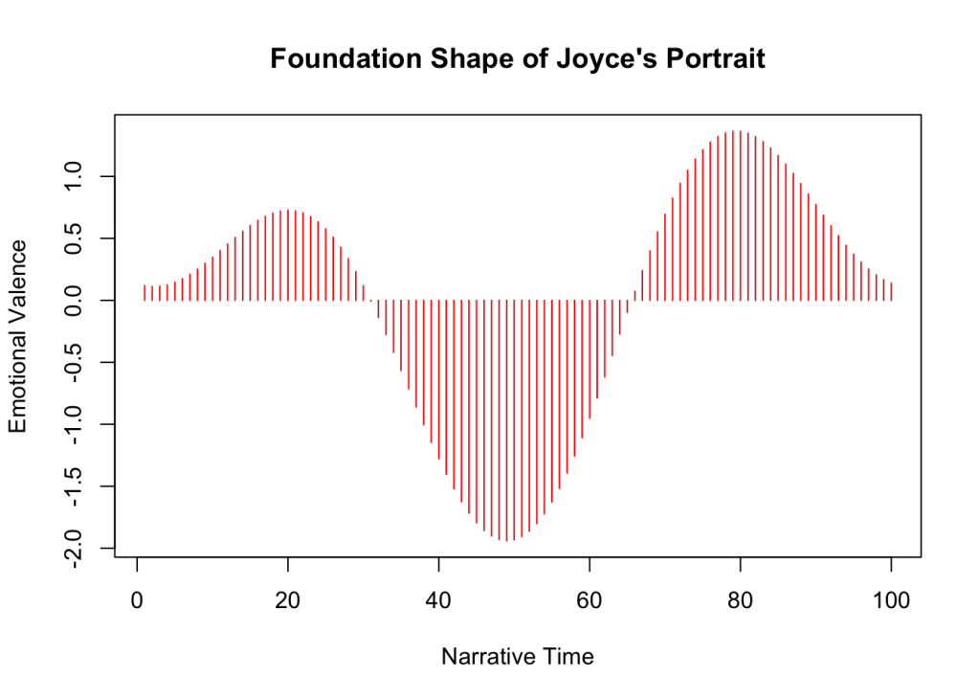

A brief history of ‘dynamic’ sentiment analysis
T. Rinker’s solution
M. Jockers’ original idea
(2015a, 2015b, Gao et al. 2016)
sentence_id word_count sentiment
1 26 0.46087292
2 17 0.00000000
3 4 0.00000000
4 4 -0.70000000
5 7 0.00000000
6 37 0.69869570
Get sentences
Apply valence shifters
Calculate ‘weighted’ sentiment
A. Swafford’s criticism (2015)
I haven’t been sad in a long time. I am extremely happy today. It’s a good day. But suddenly I’m only a little bit happy. Then I’m not happy at all.

Slide 8
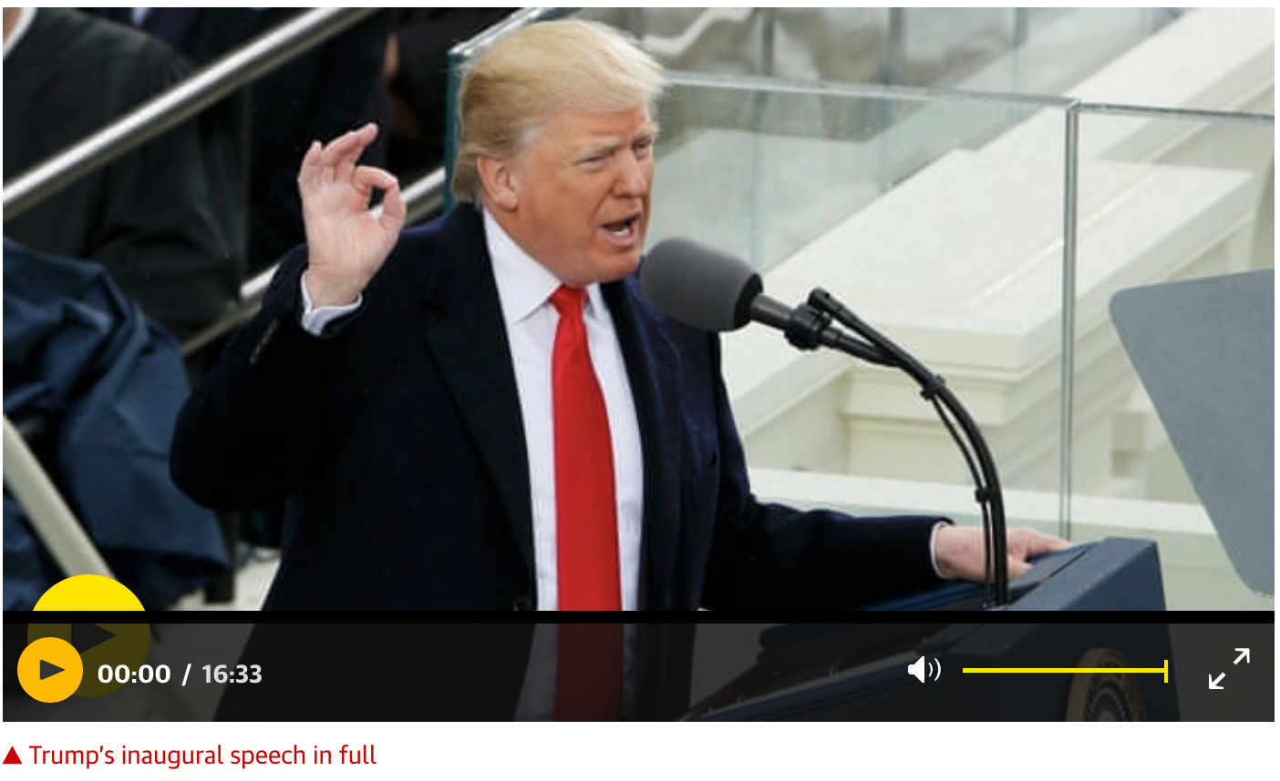
But: automatic transcription?
we the citizens of america are now joined in a great national effort to rebuild our country and restore its promise for all of our people together we will determine the course of america and the world for many many years to come we will face challenges we will confront hardships but we will get the job done every four years we gather on these steps to carry out the orderly and peaceful transfer of power and we are grateful to president obama and first lady […]
Problematic for punctuation-based approaches

Slide 9
Aims of LTTA
Look beyond static scores
Appreciate dynamics in text
Technical requirements
Needs to deal with messy data
Flexible for multiple lexicons (e.g., sentiment)
Analysis on multiple levels
Text level (intra-textual)
Individual (user) level
Meta (Forum) level

Slide 10
Approach: “Naïve” context sentiment extraction
Parse text input into words
Match sentiment lexicon to each word
Match valence shifters to each context
Apply valence shifter weights
Build a naïve context around the sentiment
Return modified sentiment
Length-standardise sentiment vector

Slide 11
> text.raw[1125:1144, ]
text index
1: we 1125
2: will 1126
3: no 1127
4: longer 1128
5: accept 1129
6: politicians 1130
7: who 1131
8: are 1132
9: all 1133
10: talk 1134
11: and 1135
12: no 1136
13: action 1137
14: – 1138
15: constantly 1139
16: complaining 1140
17: but 1141
18: never 1142
19: doing 1143
20: anything 1144
Parse text input into words
we will no longer accept politicians who are all talk and no action – constantly complaining but never doing anything about it

Slide 12
2. Match sentiment lexicon to each word
> text.raw[1125:1144, ]
text index
1: we 1125
2: will 1126
3: no 1127
4: longer 1128
5: accept 1129
6: politicians 1130
7: who 1131
8: are 1132
9: all 1133
10: talk 1134
11: and 1135
12: no 1136
13: action 1137
14: – 1138
15: constantly 1139
16: complaining 1140
17: but 1141
18: never 1142
19: doing 1143
20: anything 1144
> text.sentiment[1125:1144,]
text index y
1: we 1125 NA
2: will 1126 NA
3: no 1127 NA
4: longer 1128 NA
5: accept 1129 1.00
6: politicians 1130 NA
7: who 1131 NA
8: are 1132 NA
9: all 1133 NA
10: talk 1134 0.40
11: and 1135 NA
12: no 1136 NA
13: action 1137 0.25
14: – 1138 NA
15: constantly 1139 NA
16: complaining 1140 -1.00
17: but 1141 NA
18: never 1142 NA
19: doing 1143 NA
20: anything 1144 NA

Slide 13
2.1. Match valence shifters
> text.sentiment[1125:1144,]
text index y
1: we 1125 NA
2: will 1126 NA
3: no 1127 NA
4: longer 1128 NA
5: accept 1129 1.00
6: politicians 1130 NA
7: who 1131 NA
8: are 1132 NA
9: all 1133 NA
10: talk 1134 0.40
11: and 1135 NA
12: no 1136 NA
13: action 1137 0.25
14: – 1138 NA
15: constantly 1139 NA
16: complaining 1140 -1.00
17: but 1141 NA
18: never 1142 NA
19: doing 1143 NA
20: anything 1144 NA
> text.table[1125:1144,]
text index sentiment valence
1: we 1125 NA <NA>
2: will 1126 NA <NA>
3: no 1127 NA 1
4: longer 1128 NA <NA>
5: accept 1129 1.00 <NA>
6: politicians 1130 NA <NA>
7: who 1131 NA <NA>
8: are 1132 NA <NA>
9: all 1133 NA <NA>
10: talk 1134 0.40 <NA>
11: and 1135 NA <NA>
12: no 1136 NA 1
13: action 1137 0.25 <NA>
14: – 1138 NA <NA>
15: constantly 1139 NA <NA>
16: complaining 1140 -1.00 <NA>
17: but 1141 NA 4
18: never 1142 NA 1
19: doing 1143 NA <NA>
20: anything 1144 NA <NA>

Slide 14
Valence shifters
1 = negator (not, never, …) -1.00
2 = amplifier (very, totally, …) 1.50
3 = deamplifier (hardly, barely, …) 0.50
4 = adversative conjunction (but, however, …) 0.25

Slide 15
2.2. Apply valence shifter weights
> text.table[1125:1144,]
text index sentiment valence
1: we 1125 NA <NA>
2: will 1126 NA <NA>
3: no 1127 NA 1
4: longer 1128 NA <NA>
5: accept 1129 1.00 <NA>
6: politicians 1130 NA <NA>
7: who 1131 NA <NA>
8: are 1132 NA <NA>
9: all 1133 NA <NA>
10: talk 1134 0.40 <NA>
11: and 1135 NA <NA>
12: no 1136 NA 1
13: action 1137 0.25 <NA>
14: – 1138 NA <NA>
15: constantly 1139 NA <NA>
16: complaining 1140 -1.00 <NA>
17: but 1141 NA 4
18: never 1142 NA 1
19: doing 1143 NA <NA>
20: anything 1144 NA <NA>
> text.table[1125:1144,]
text index sentiment valence weights
1: we 1125 NA <NA> 1.00
2: will 1126 NA <NA> 1.00
3: no 1127 NA 1 -1.00
4: longer 1128 NA <NA> 1.00
5: accept 1129 1.00 <NA> 1.00
6: politicians 1130 NA <NA> 1.00
7: who 1131 NA <NA> 1.00
8: are 1132 NA <NA> 1.00
9: all 1133 NA <NA> 1.00
10: talk 1134 0.40 <NA> 1.00
11: and 1135 NA <NA> 1.00
12: no 1136 NA 1 -1.00
13: action 1137 0.25 <NA> 1.00
14: – 1138 NA <NA> 1.00
15: constantly 1139 NA <NA> 1.00
16: complaining 1140 -1.00 <NA> 1.00
17: but 1141 NA 4 0.25
18: never 1142 NA 1 -1.00
19: doing 1143 NA <NA> 1.00
20: anything 1144 NA <NA> 1.00

Slide 16
2.3. Build context
> text.table[1125:1144,]
text index sentiment valence weights
1: we 1125 NA <NA> 1.00
2: will 1126 NA <NA> 1.00
3: no 1127 NA 1 -1.00
4: longer 1128 NA <NA> 1.00
5: accept 1129 1.00 <NA> 1.00
6: politicians 1130 NA <NA> 1.00
7: who 1131 NA <NA> 1.00
8: are 1132 NA <NA> 1.00
9: all 1133 NA <NA> 1.00
10: talk 1134 0.40 <NA> 1.00
11: and 1135 NA <NA> 1.00
12: no 1136 NA 1 -1.00
13: action 1137 0.25 <NA> 1.00
14: – 1138 NA <NA> 1.00
15: constantly 1139 NA <NA> 1.00
16: complaining 1140 -1.00 <NA> 1.00
17: but 1141 NA 4 0.25
18: never 1142 NA 1 -1.00
19: doing 1143 NA <NA> 1.00
20: anything 1144 NA <NA> 1.00
text index sentiment valence weights
3: no 1127 NA 1 -1.00
4: longer 1128 NA <NA> 1.00
5: accept 1129 1.00 <NA> 1.00
6: politicians 1130 NA <NA> 1.00
7: who 1131 NA <NA> 1.00
11: and 1135 NA <NA> 1.00
12: no 1136 NA 1 -1.00
13: action 1137 0.25 <NA> 0.25
14: – 1138 NA <NA> 1.00
15: constantly 1139 NA <NA> 1.00

Slide 17
2.3. Calculate modified sentiment
text index sentiment valence weights
3: no 1127 NA 1 -1.00
4: longer 1128 NA <NA> 1.00
5: accept 1129 1.00 <NA> 1.00
6: politicians 1130 NA <NA> 1.00
7: who 1131 NA <NA> 1.00
11: and 1135 NA <NA> 1.00
12: no 1136 NA 1 -1.00
13: action 1137 0.25 <NA> 0.25
14: – 1138 NA <NA> 1.00
15: constantly 1139 NA <NA> 1.00
prod(c(-1.00, 1.00, 1.00, 1.00, 1.00))
= -1.00
prod(c(1.00, -1.00, 0.25, 1.00, 1.00))
= -0.25

Slide 18
3. Length-standardisation
> text.table[1125:1144, c(1,7)]
text sentiment_score_mod
1: we 0.00
2: will 0.00
3: no 0.00
4: longer 0.00
5: accept -1.00
6: politicians 0.00
7: who 0.00
8: are 0.00
9: all 0.00
10: talk -0.40
11: and 0.00
12: no 0.00
13: action -0.25
14: – 0.00
15: constantly 0.00
16: complaining 0.25
17: but 0.00
18: never 0.00
19: doing 0.00
20: anything 0.00
Discrete cosine transformation
Number of bins
Low pass filter (smoothing)
Scaling
get_dct_transform(
raw_values = text.table$sentiment_score_mod
, x_reverse_len= 100 #bins
, low_pass_size = 5 #smoothing filter size
, scale_range = TRUE #scale from -1 to 1
, scale_vals = FALSE #normalize_values
)
→ Returns a vector of 100 bins

Slide 19
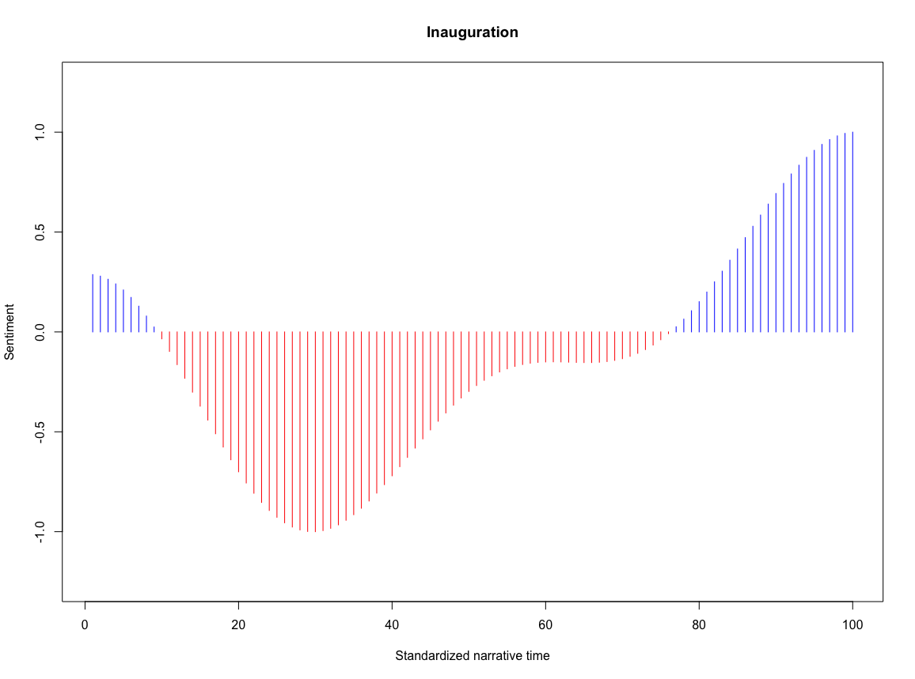
3. Length-standardisation
0.287064055 0.279204987 0.263587557 0.240411742 0.209973955 0.172662836 0.128953747 0.079402034 0.024635189
-0.034656010. -0.097727210 -0.163790930 -0.232027567 -0.301596806 […]
2-dimensional space of:
Standardised temporal progression
Smoothed sentiment

Slide 20
“Generalized” LTTA
Sentiment only one dimension
Extensible to other lexicon-based constructs
Different levels of analysis

Slide 21

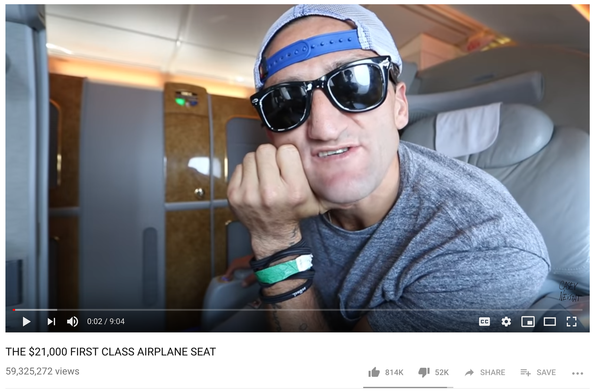
“Generalized” LTTA: Levels of analysis
Meta
Individual
Intratextual

Slide 22
“Generalized” LTTA: Levels of analysis
Intra-textual
Dynamics within a text input
Non-standardised temporal axis (~ time series)
Standardisation needed for comparison

Slide 23
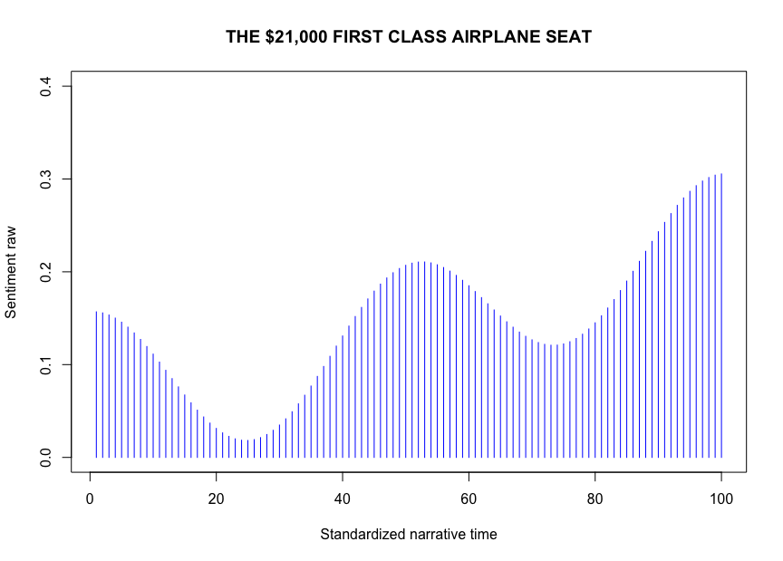
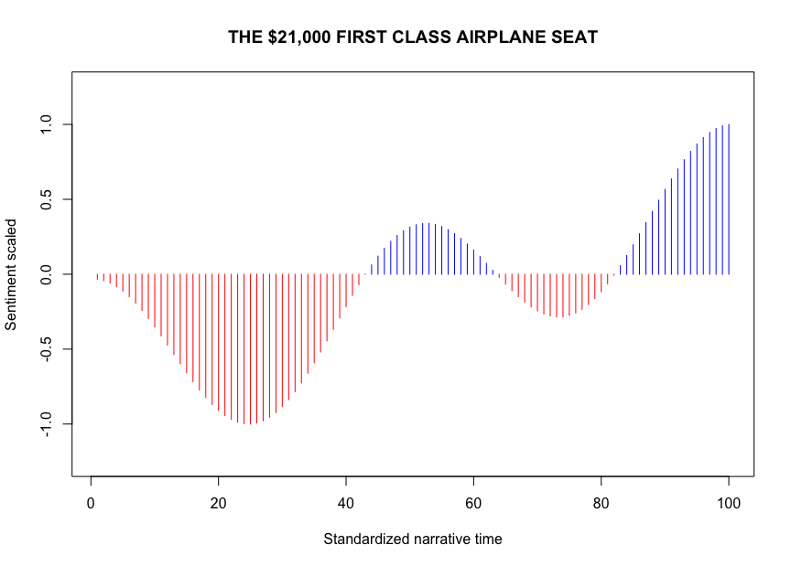
Levels of analysis: intra-textual

Slide 24
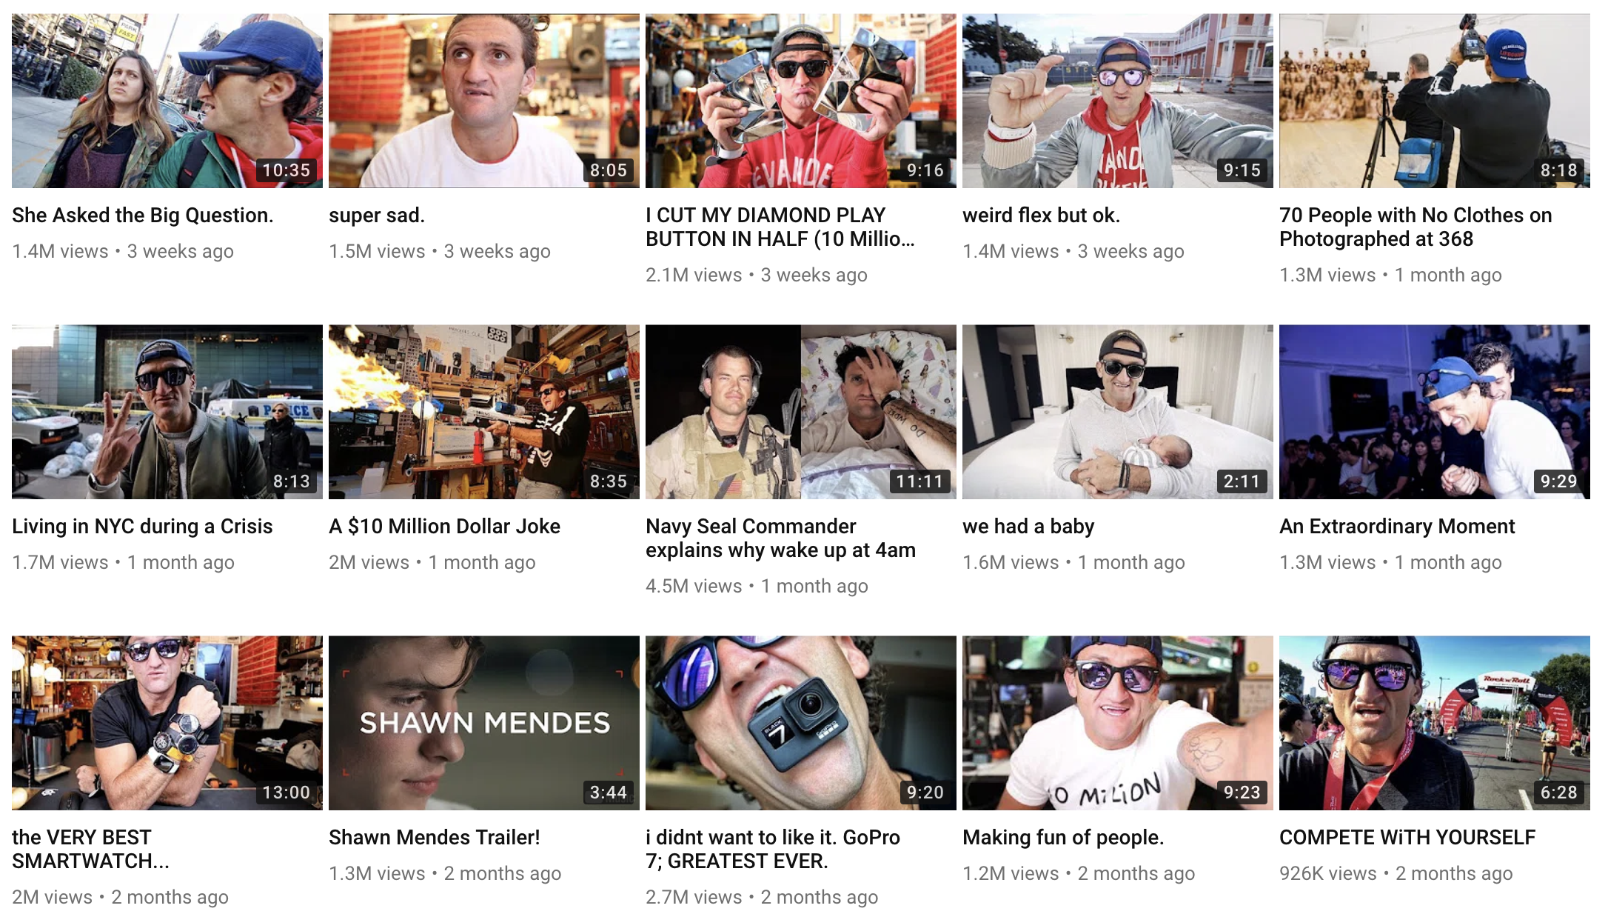
“Generalized” LTTA: Levels of analysis
Individual level
Construct (e.g. sentiment) development across texts
Standardisation to ‘narrative progression’ for comparison

Slide 25
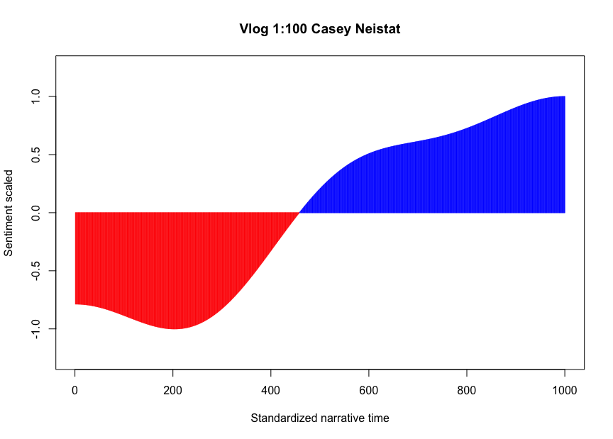
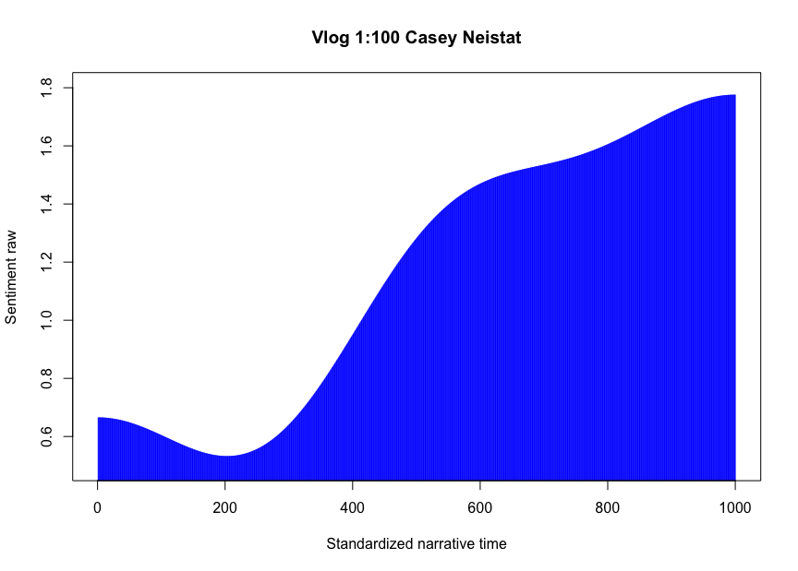
Levels of analysis: individual

Slide 26
“Generalized” LTTA: Levels of analysis
Meta level
Development of individuals (or the whole of texts) in a forum/platform/website
Standardisation needed for comparison
All vloggers on
… (more on a few minutes)

Slide 27
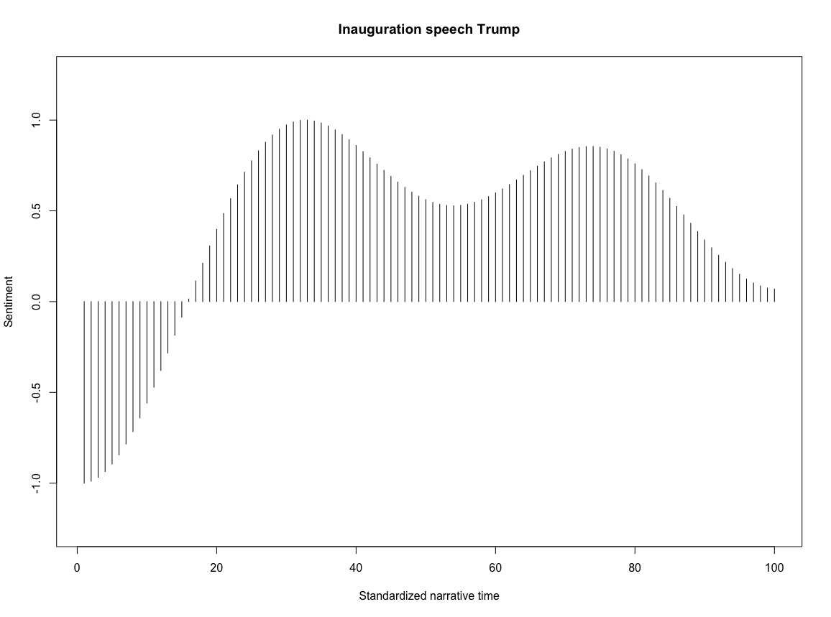
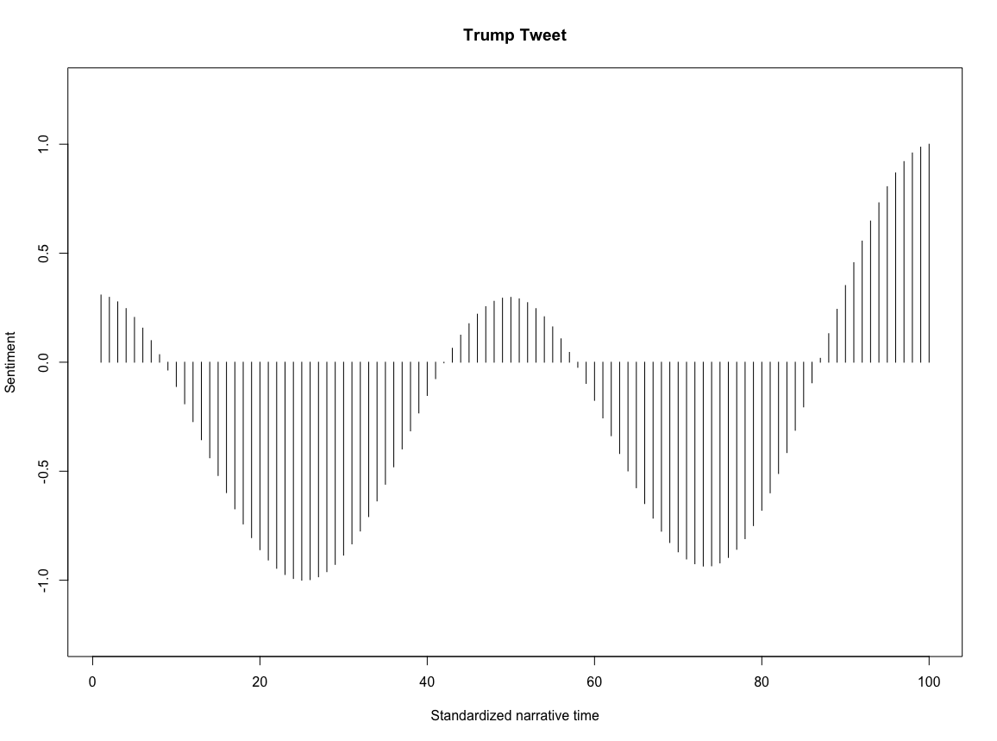
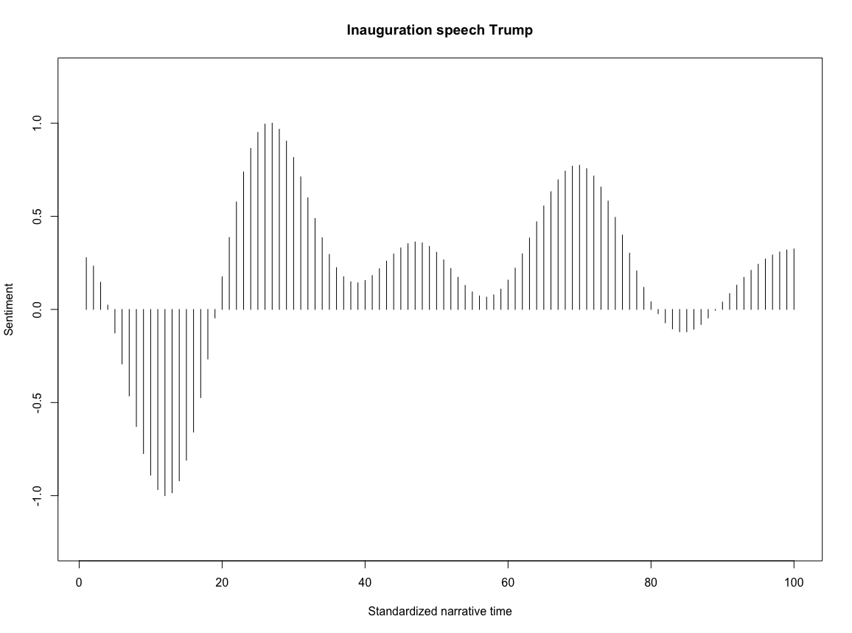
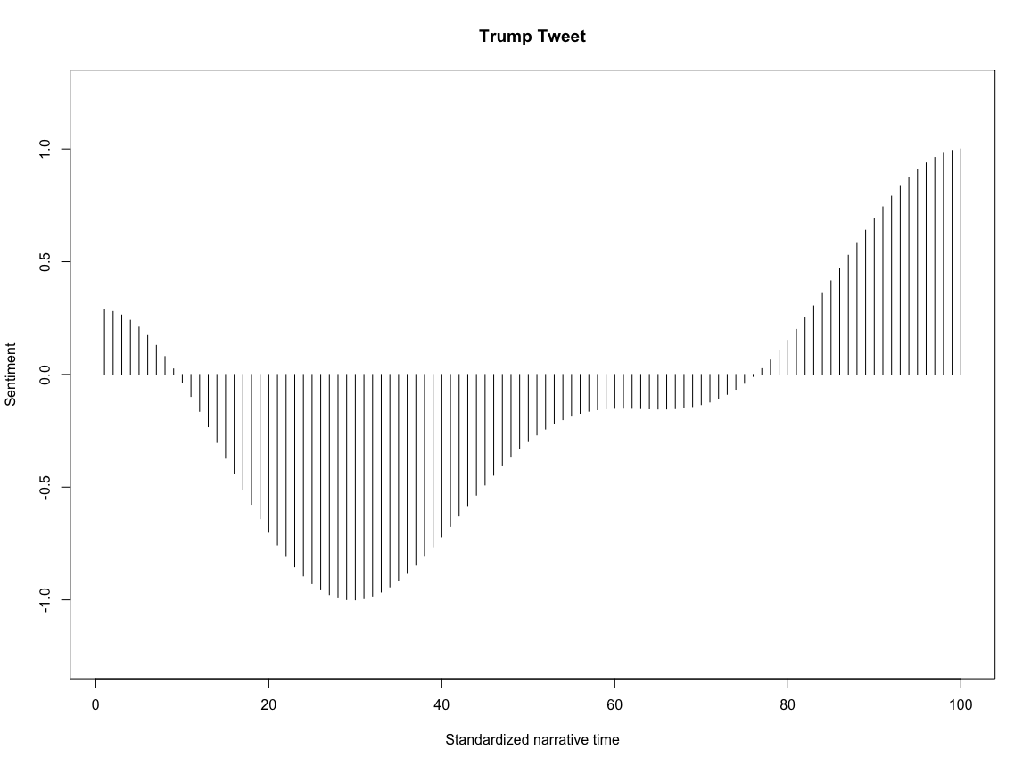
Beware of ‘researcher’s degrees of freedom’
LFP = 5
Wide window
The usual text mining decisions
Stemming, lemmatization, punctuation, contractions, abbreviations, …
New decisions:
“context window” size?
Low pass filter size?
Valence shifter weights?
Scaling?
LFP = 10
Narrow window

Slide 28

Why bother?

Slide 29
Outlook
Beyond sentiment
Abusive language
Vulgarity
Complexity
Extensions
Time-series modelling
Event modelling
Supervised ML with shape coordinates
Predicting progression?

Slide 30






RQs we can answer with LTTA
47 views
47,000,000 views

Slide 31

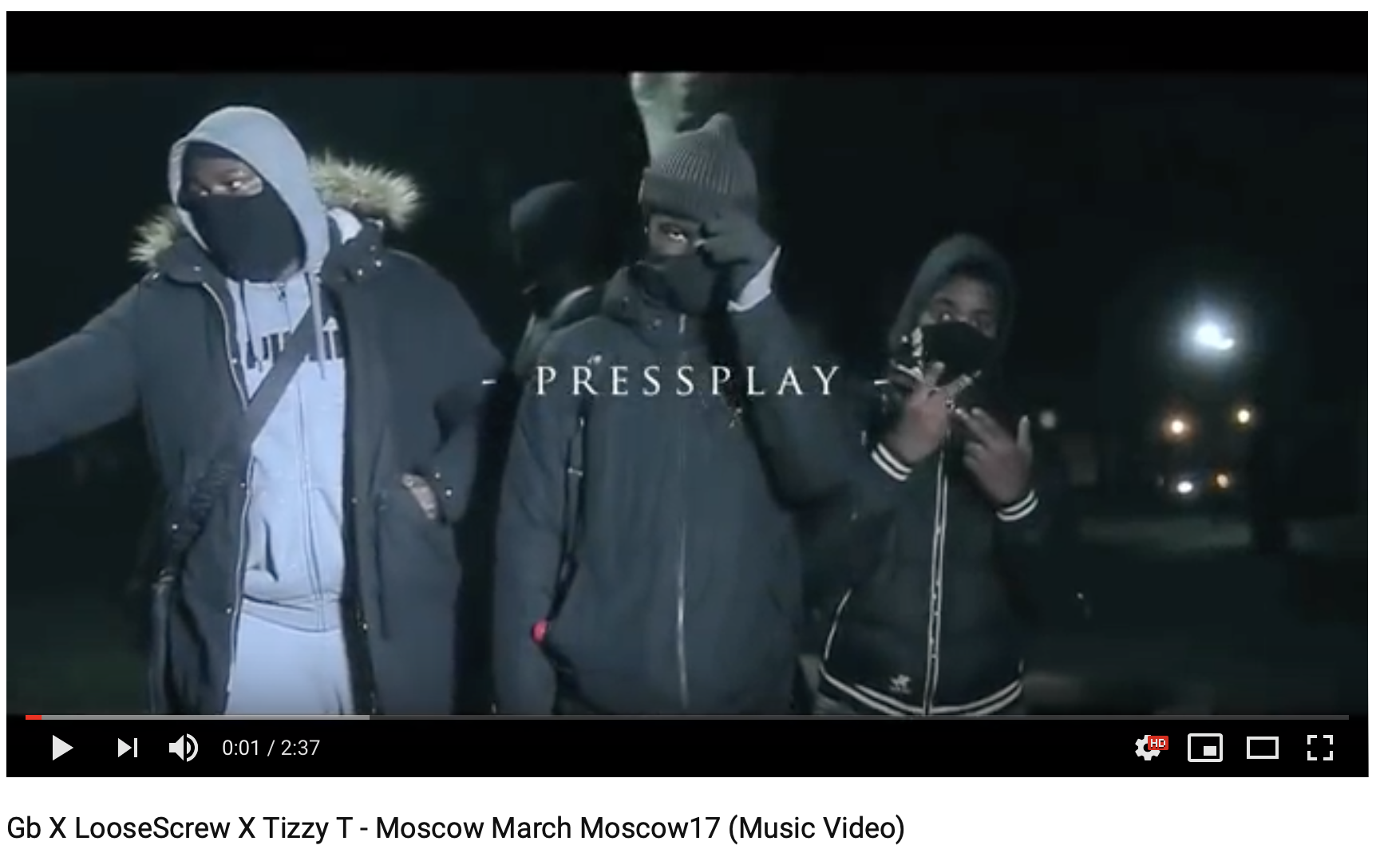
RQs we need to answer (maybe LTTA can help?)
Misinformation
Deception detection
Language escalation
“Explainable” methods
Identify where fake articles differ from genuine articles
→ highlight suspicious parts of text
Biggest challenge: embedded lies

Slide 32
About this workshop
All slides, data, code, … openly available
Morning part:
Examples of LTTA
Practical in R
Afternoon part:
Paper hackathon

